Slide 1
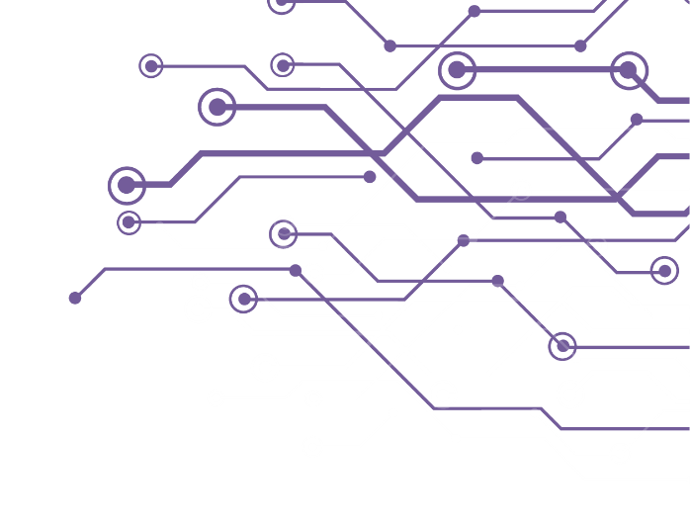
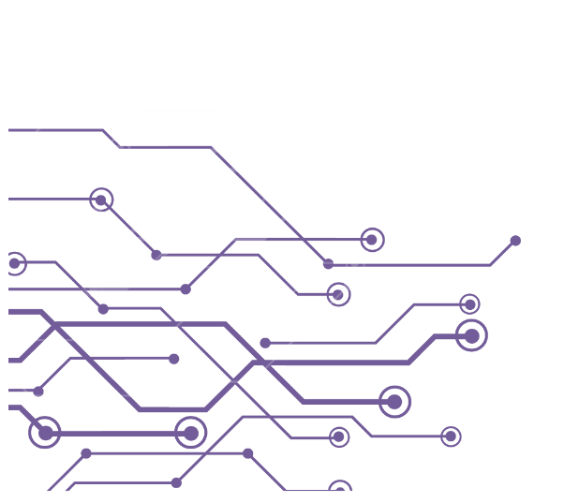

BITCOIN INTRO COURSE
Understanding
What Money Is
Why It Is Broken
What Bitcoin Is
How Bitcoin Works
How to Use Bitcoin
What Money Is
Why It Is Broken
What Bitcoin Is
How Bitcoin Works
How to Use Bitcoin

Slide 2

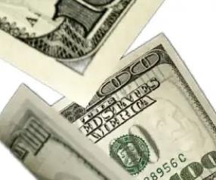

Understanding Money
It is well enough that people of the nation do not understand our banking and monetary system, for if they did, I believe there would be a revolution before tomorrow morning.
Money is the most marketable good which people acquire because they want to offer it in later acts of interpersonal exchange
Henry Ford
Ludwig von Mises

Slide 3
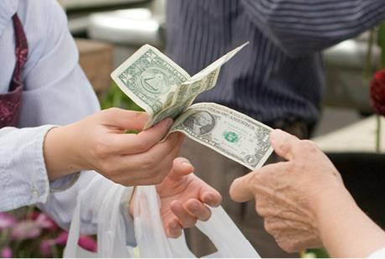
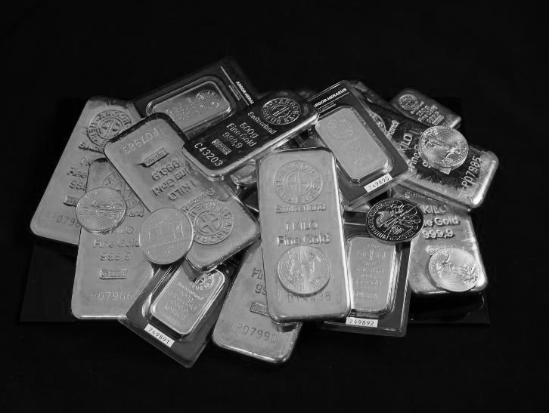
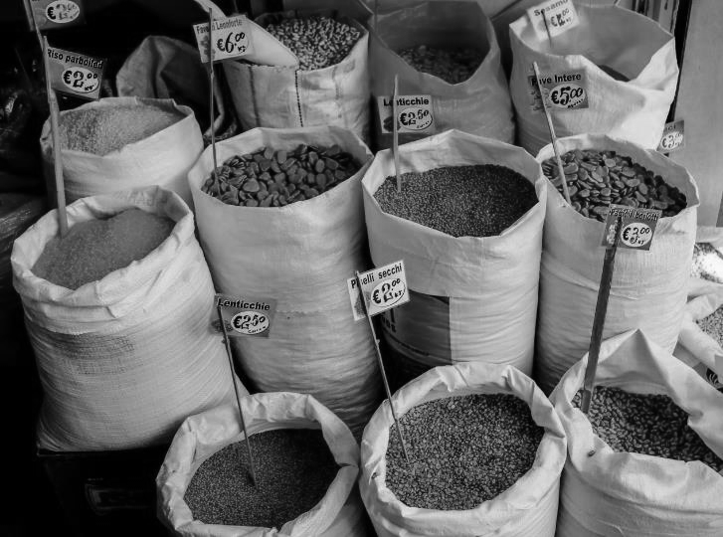
Functions of Money
Medium of Exchange
Store of Value
Unit of Account

Slide 4
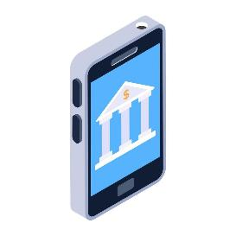

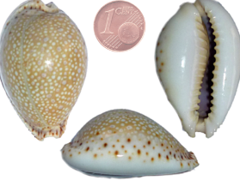
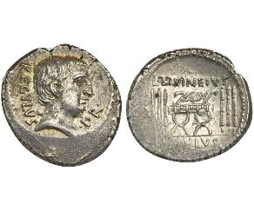
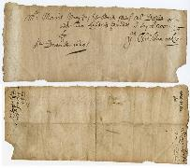
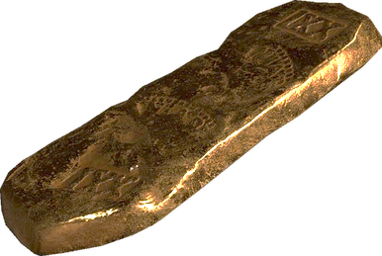
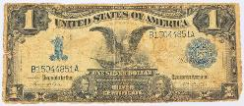
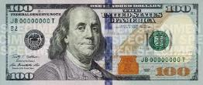
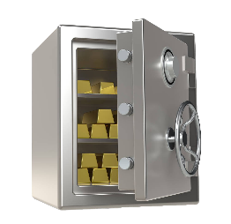
Evolution of Money
Decentralized & Digital
Primitive
Precious Metals
Gold-Backed
Fiat
GOV’T ISSUED
BANKNOTE
TIME
What people consider money changes over time

Slide 5

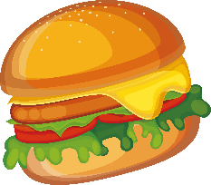
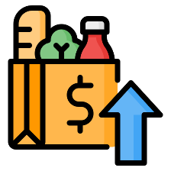
Consequences of Fiat Money
INPUT PRICES RISE
HIDE INCREASE
RAISE PRICES
DETERIORATION
SHRINKFLATION
PRICE INFLATION
Reduce Quality of Ingredients
Reduce Quantity of Ingredients
Pass on Costs to Customers

Slide 6
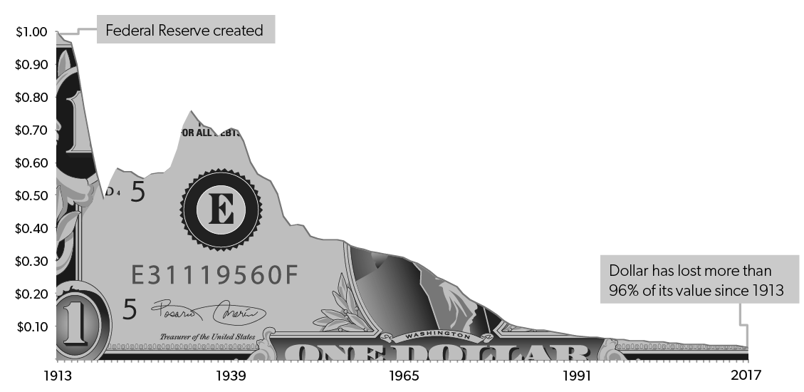
Purchasing Power of the U.S. Dollar 1913-2017
Federal Reserve Created
Dollar has lost more than 96% of its value since 1913

Slide 7

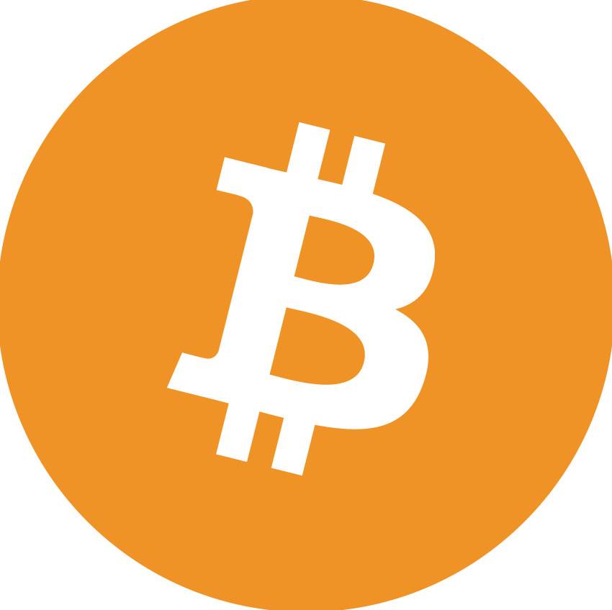
What is Bitcoin?
Bitcoin is a decentralized digital currency that is finite and exists outside of the control of governments and banks

Slide 8
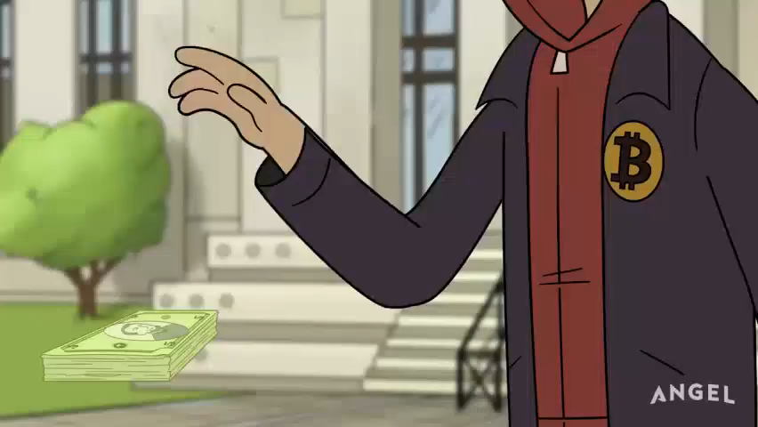

Slide 9

Fiat System
VS
Bitcoin
Centralized
Closed
Controlled by central banks and governments
Unlimited Supply
Decentralized
Open
Peer to peer
Uncounterfeitable
Finite

Slide 10
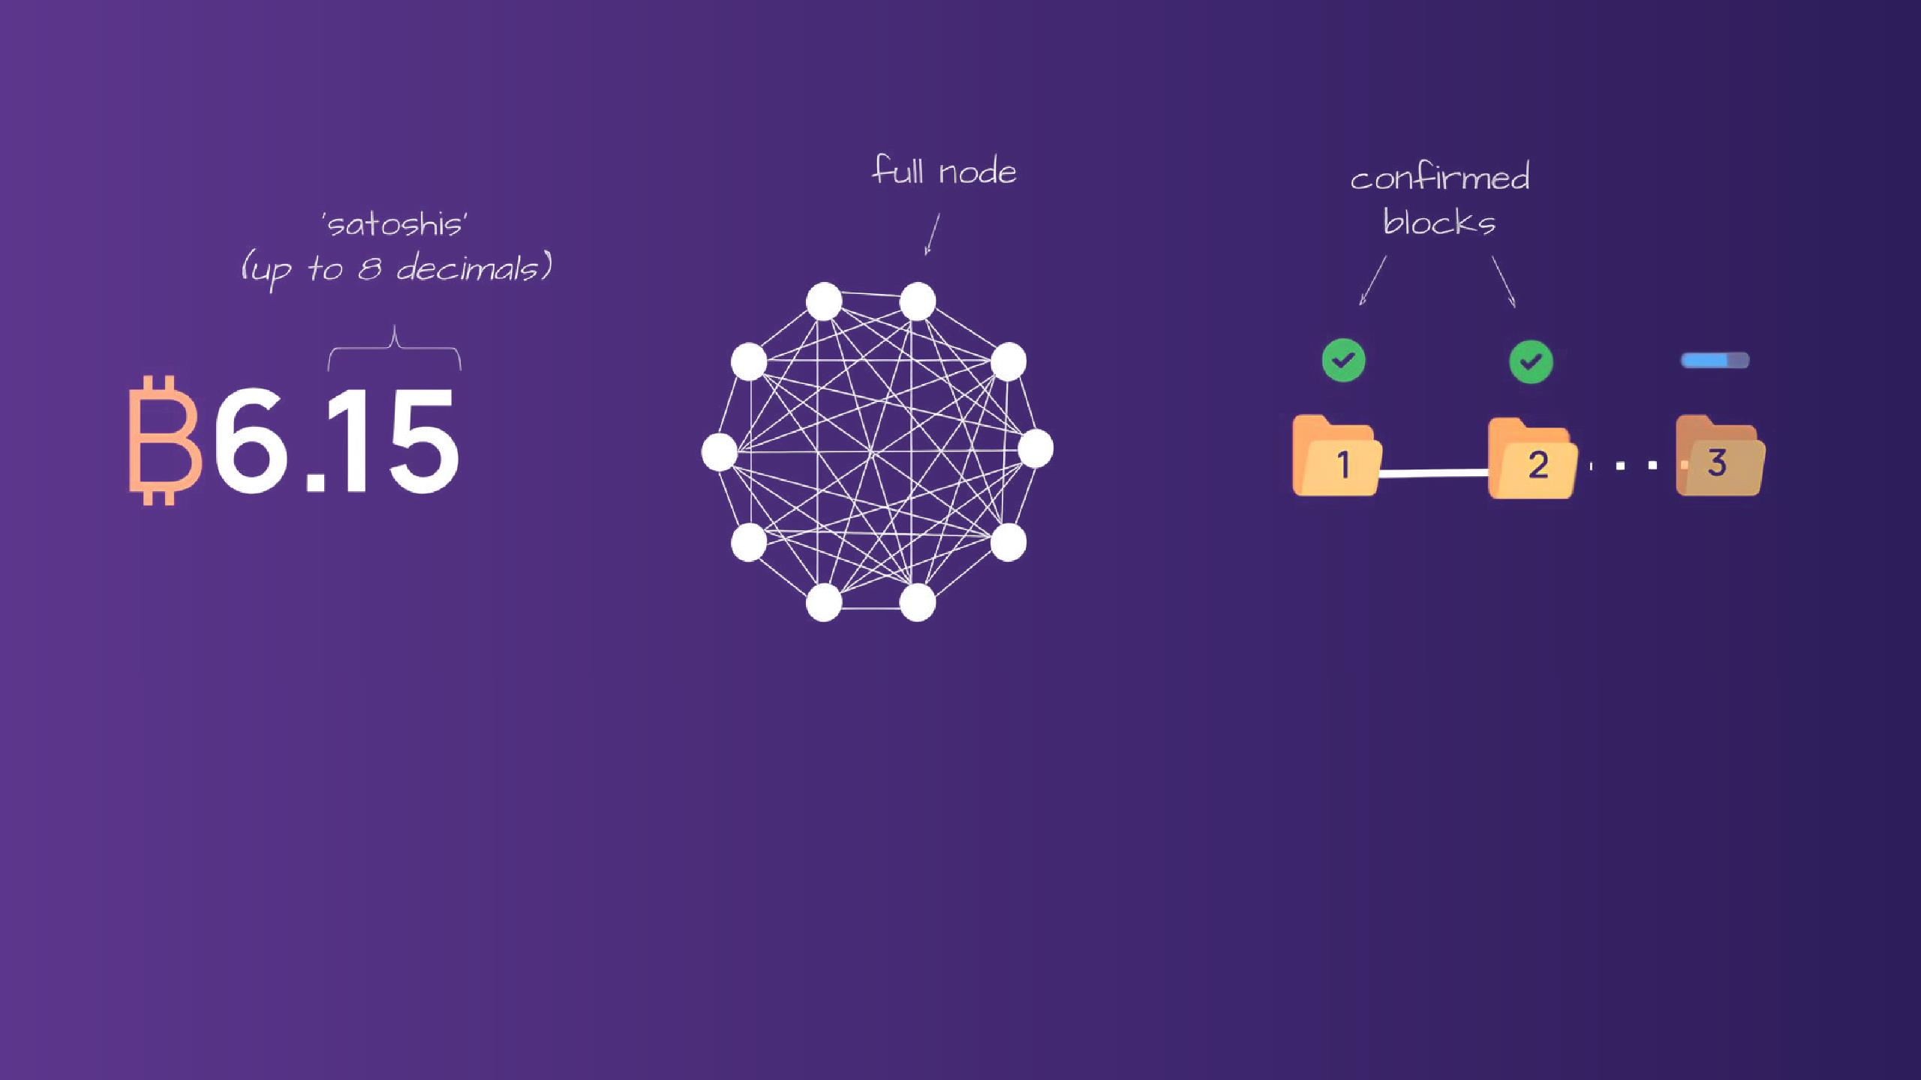
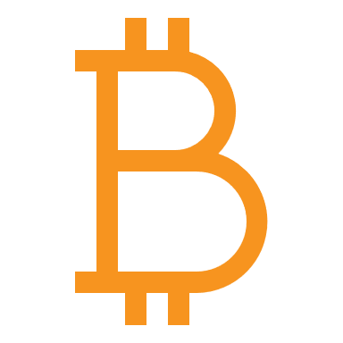
bitcoin
the network
the blockchain
Monetary unit
Connected nodes with a common ruleset
linked record of verified transactions

Slide 11
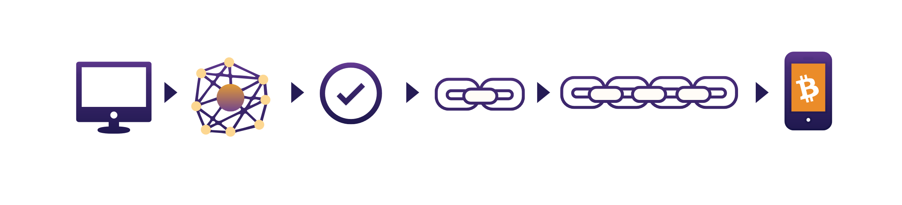
Peer-to-Peer Transactions
Someone Request a transaction
Transaction broadcasted to P2P computers (nodes)
Miners verify the transaction
Transactions combined to form a data block
New block added to the existing blockchain
The transaction is complete

Slide 12

Bitcoin as Sound Digital Money
21 Trillion
21 Million
U.S. M2 Money Supply
1960-2023
Bitcoin Money Supply
2009-2140

Slide 13
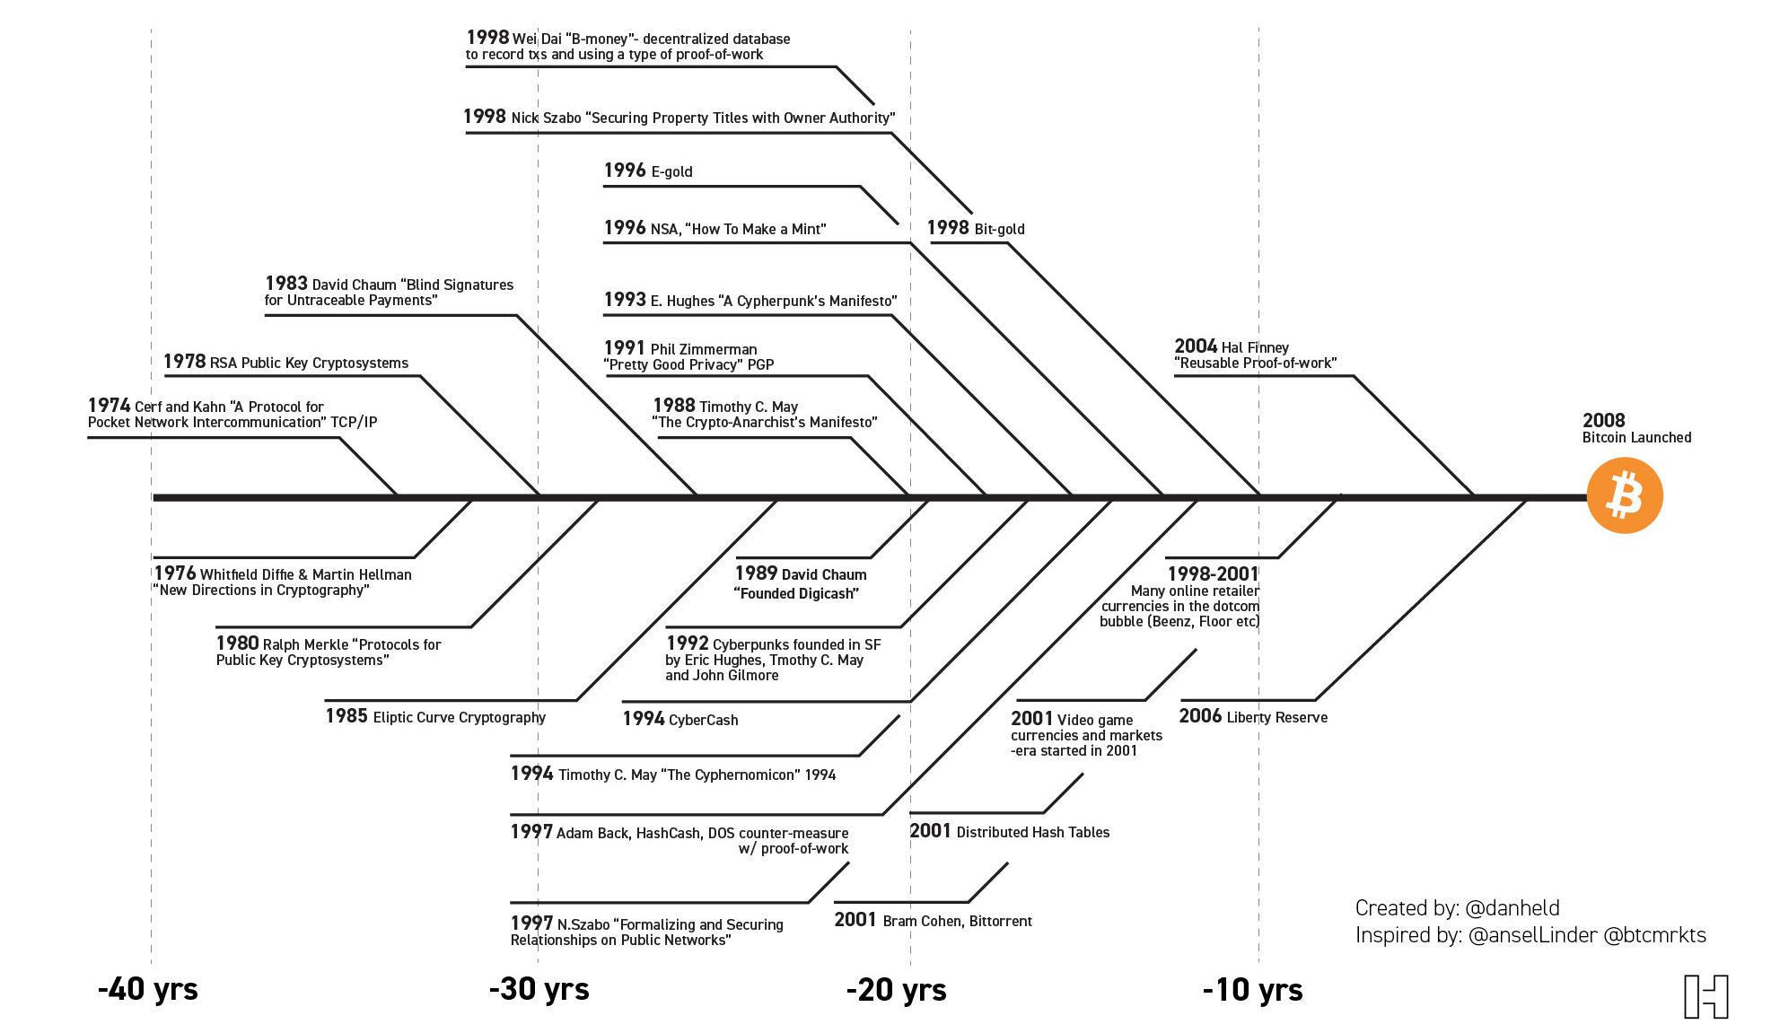
Bitcoin’s Creation
It’s the result of 40 years of research, development and demand.
-40 years
-30 years
-20 years
-10 years

Slide 14
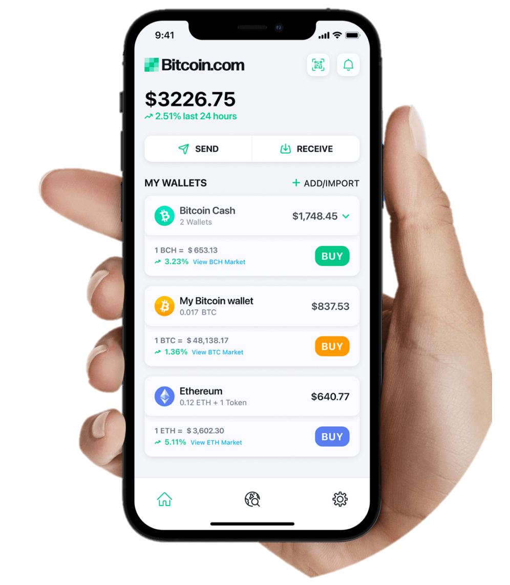
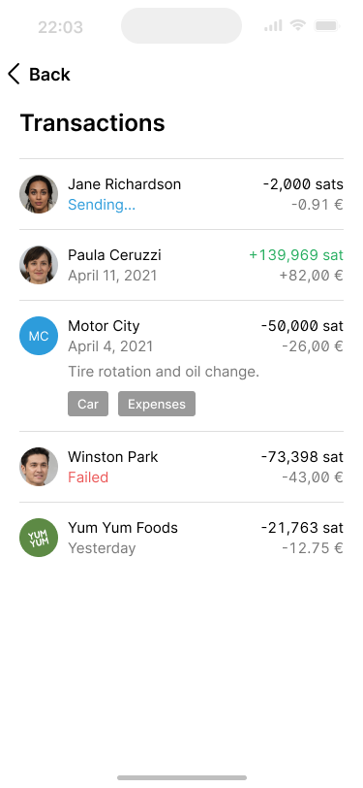
What is a Bitcoin Wallet
A wallet is the interface you use to send and receive Bitcoin transactions.
Seed Phrase
Private Key
Public Key
Address

Slide 15


Custodial vs Non-Custodial Wallets
Self-Custodial
Custodial
Signing Key
User
Provider/bank
Network
(No intermediaries, you own the Bitcoin)
Network (Provider is intermediary, you don't own the Bitcoin but a claim on them)

Slide 16




How to Create a Bitcoin Wallet and use Lightning
Items Required
Smartphone
Internet access
Pen
Paper
01
02
03
04
05
06
Create a new Bitcoin wallet
Back up the Seed/Signing Key on paper
Verify the backup in the application.
Generate new invoice
Receive payment
Download the app

Slide 17
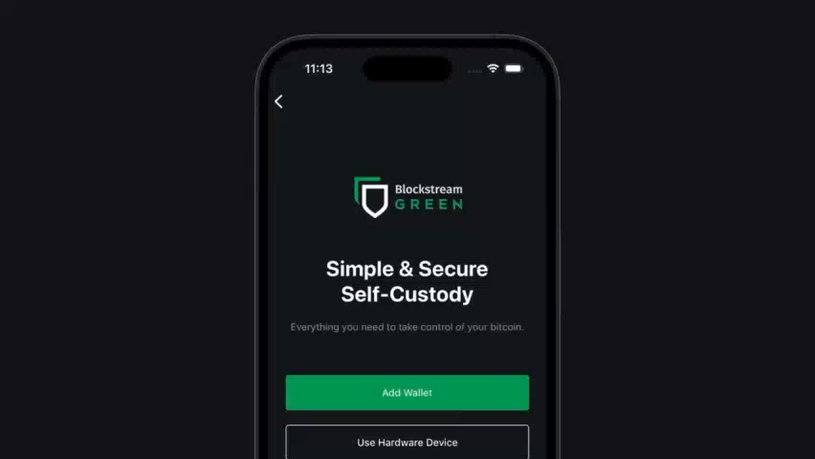

Slide 18
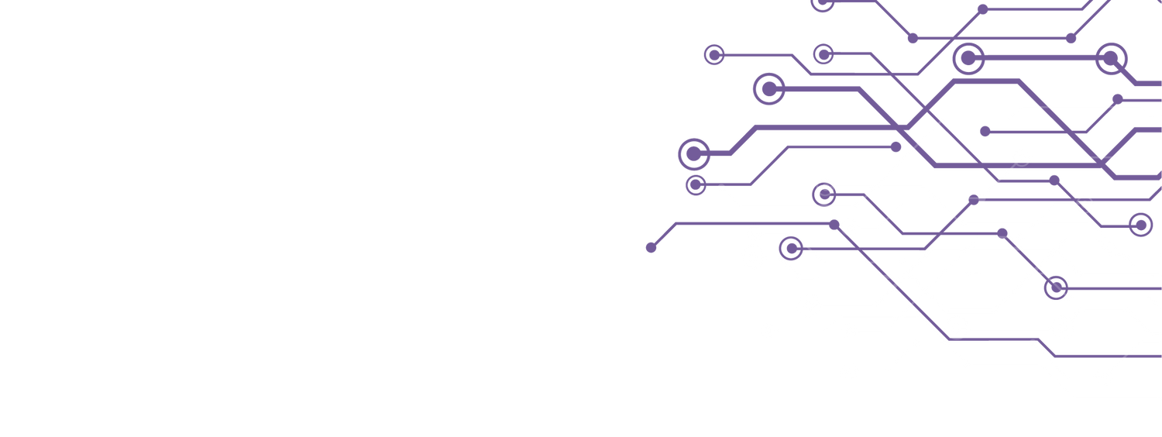
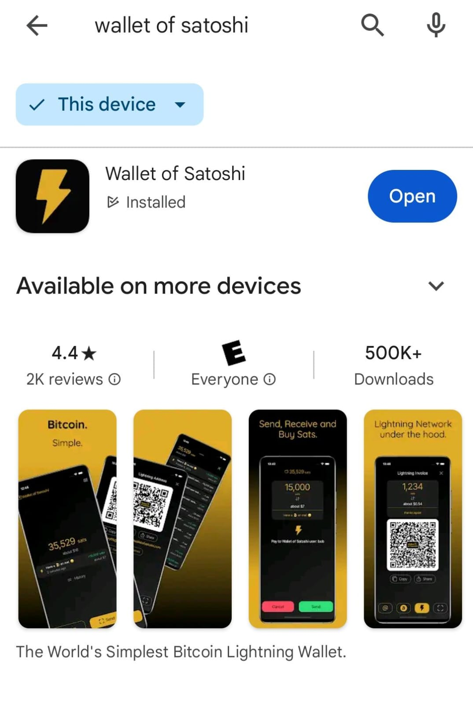
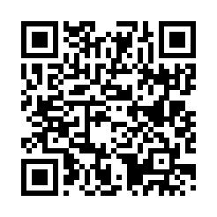
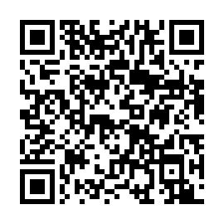
Downloading your first Bitcoin wallet
Download for iOS
Download for Android
This is how it looks:
De custodia
‹#›

Slide 19
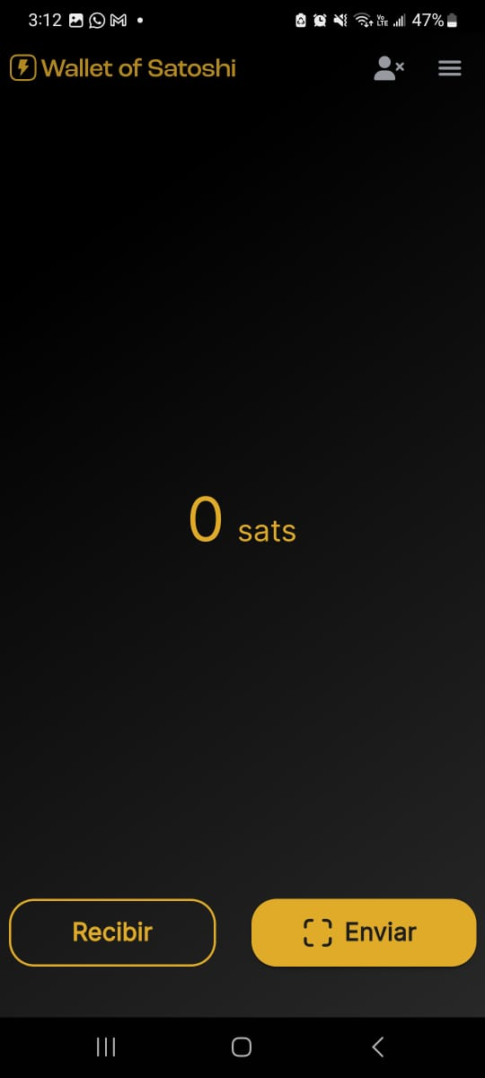
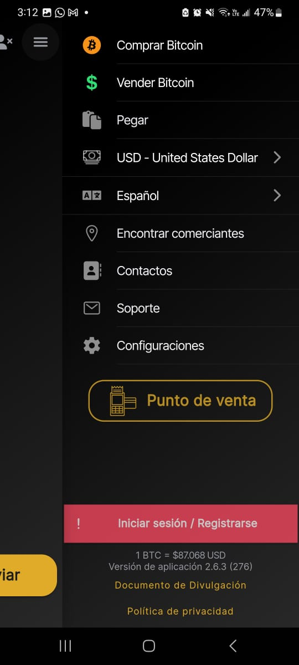
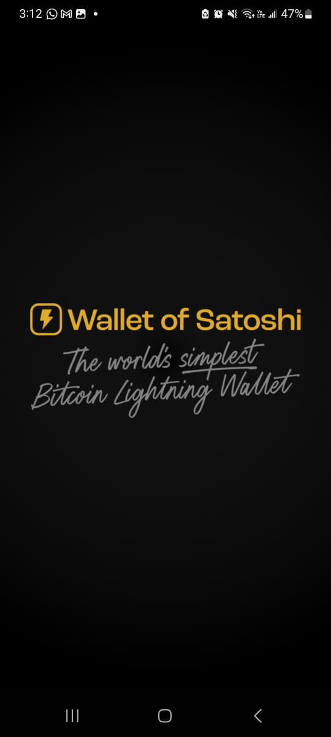
Creating a custodial wallet
Step 1:
Step 2:
Step 3:
‹#›

Slide 20
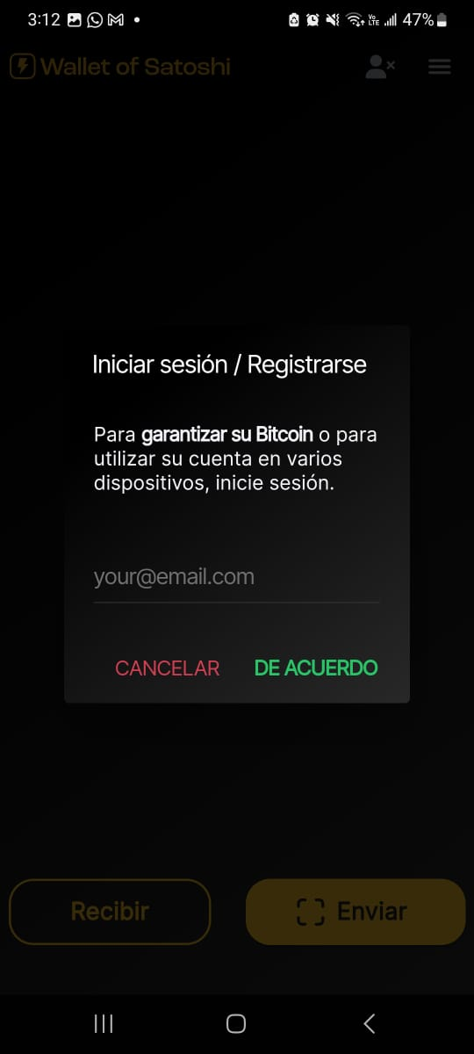
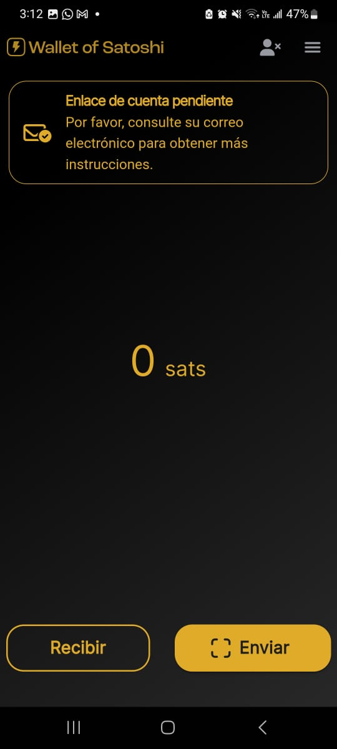
Creating a custodial wallet
Step 4:
Step 5:
‹#›

Slide 21
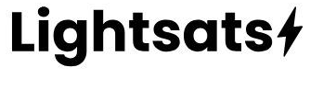
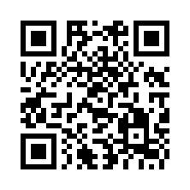
Get your first sats SATS
‹#›

Slide 22
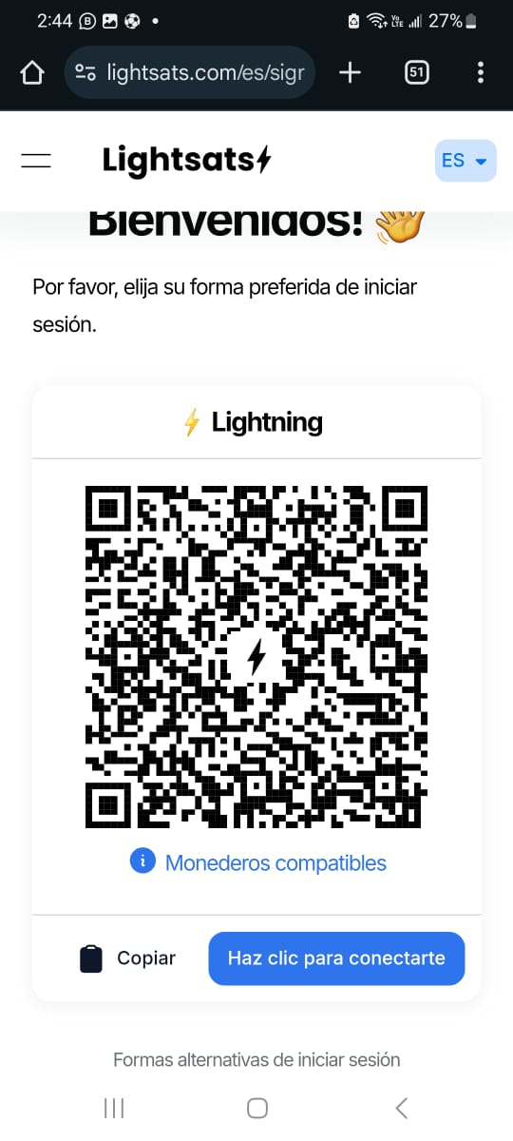
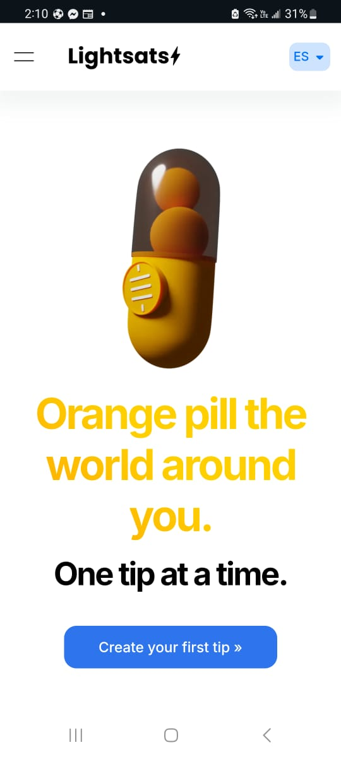
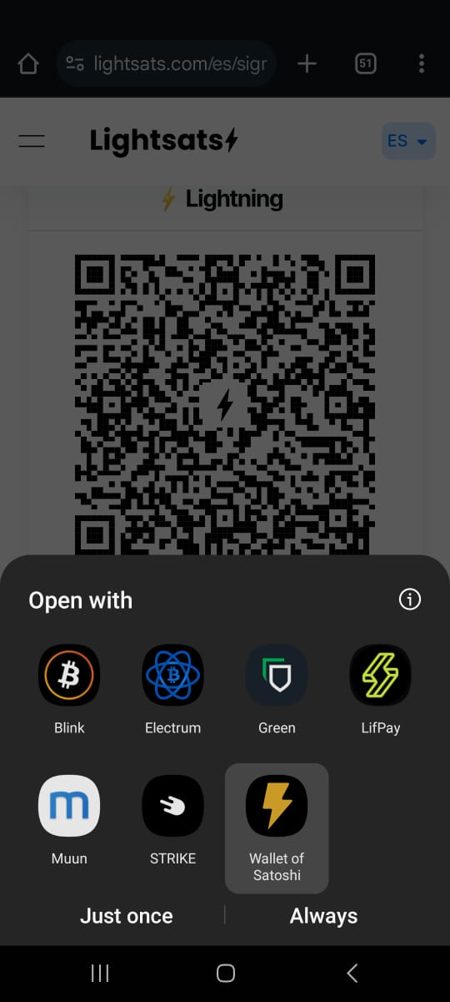
Signing up on Lightsats
Step 6:
Step 7:
Step 8:
‹#›

Slide 23
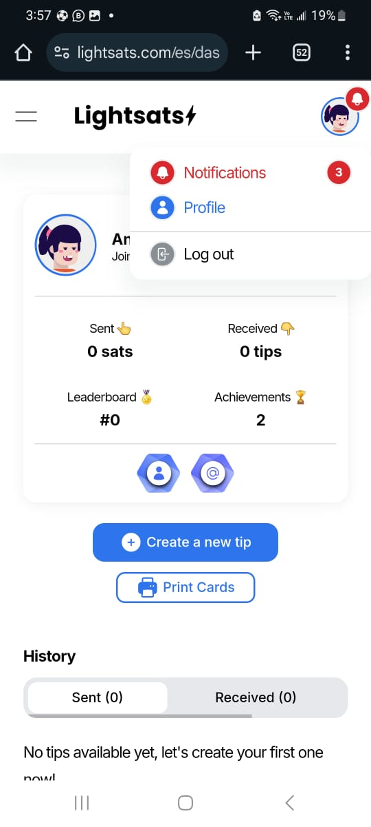
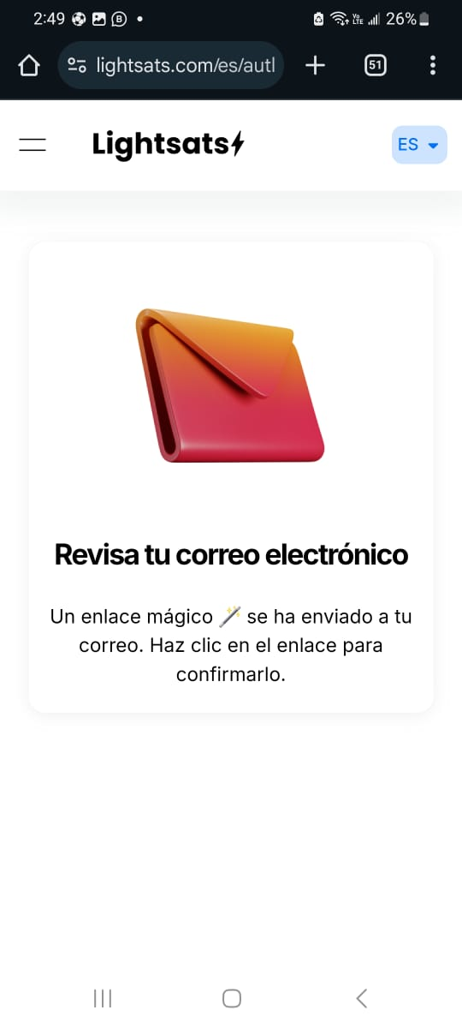
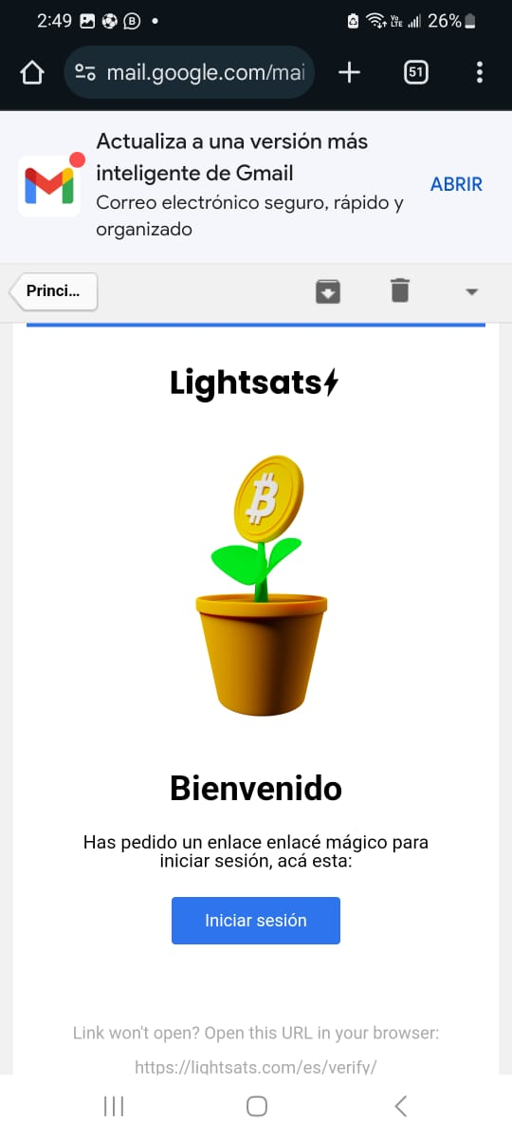
Lightsats Platform
Paso 9:
Paso 10:
‹#›

Slide 24
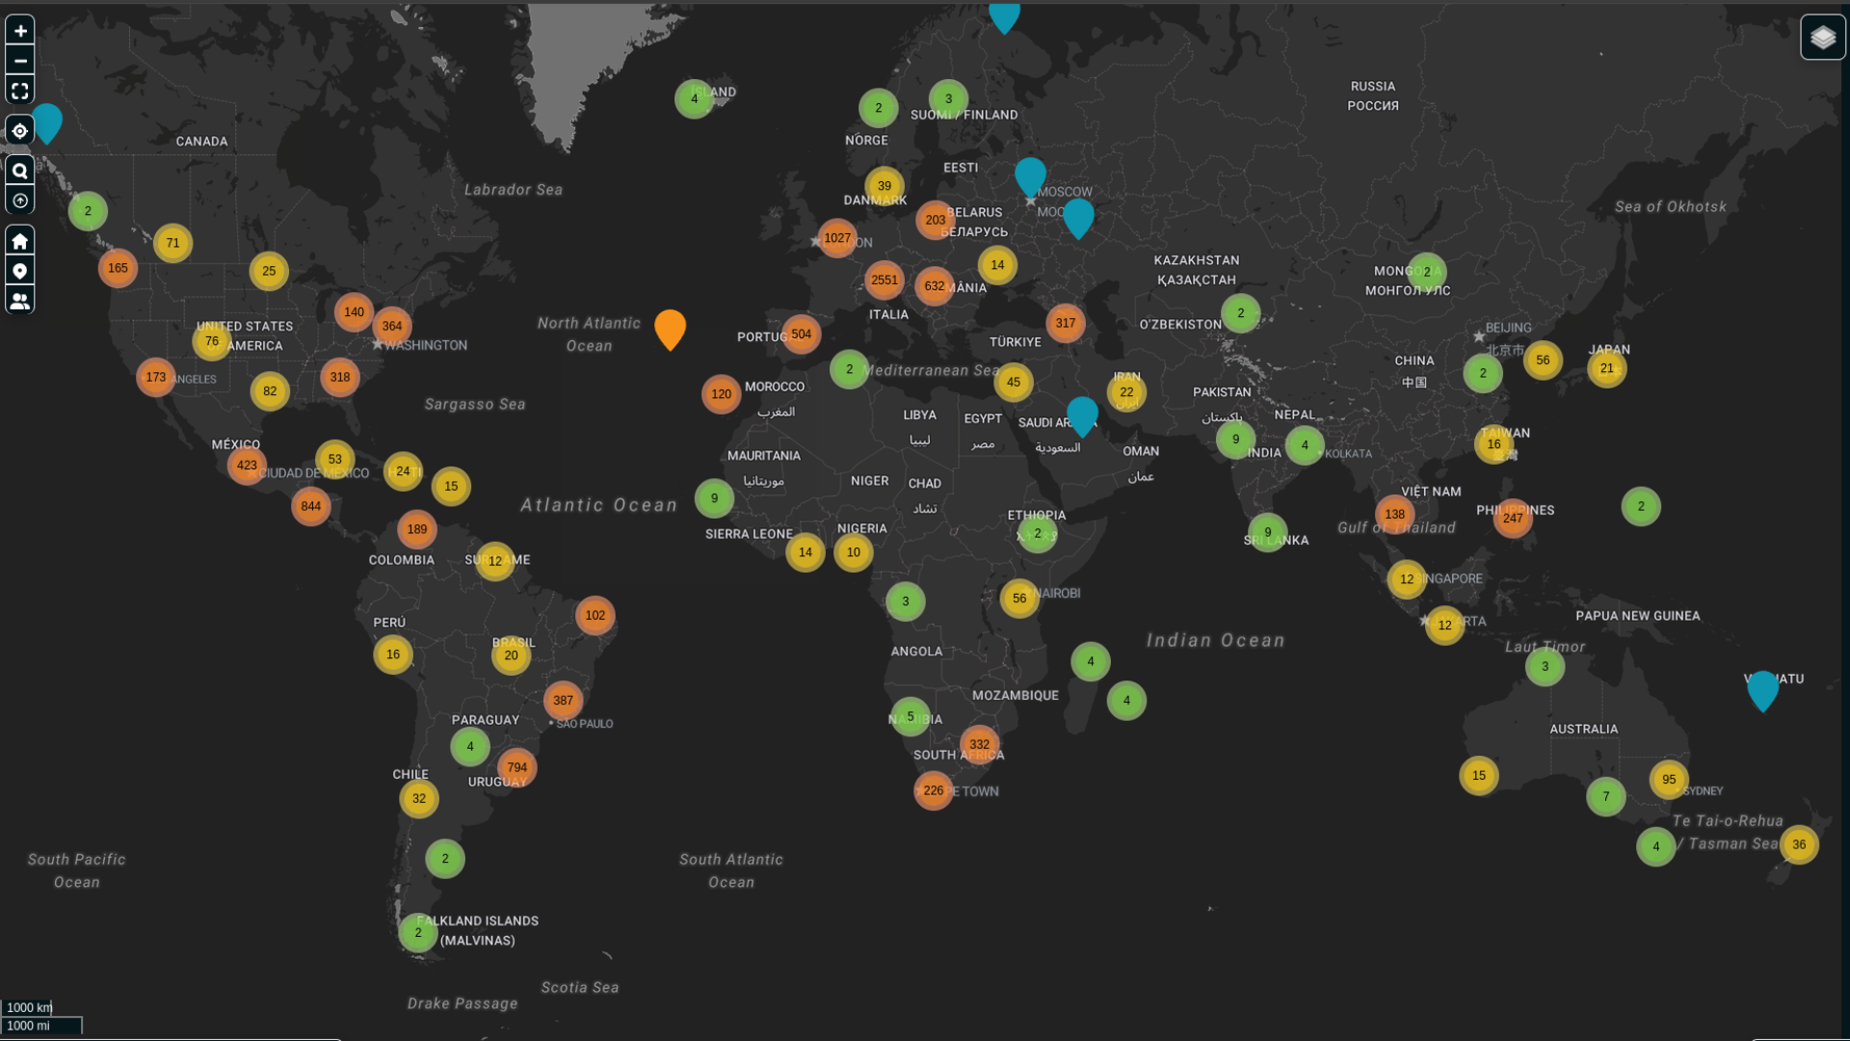
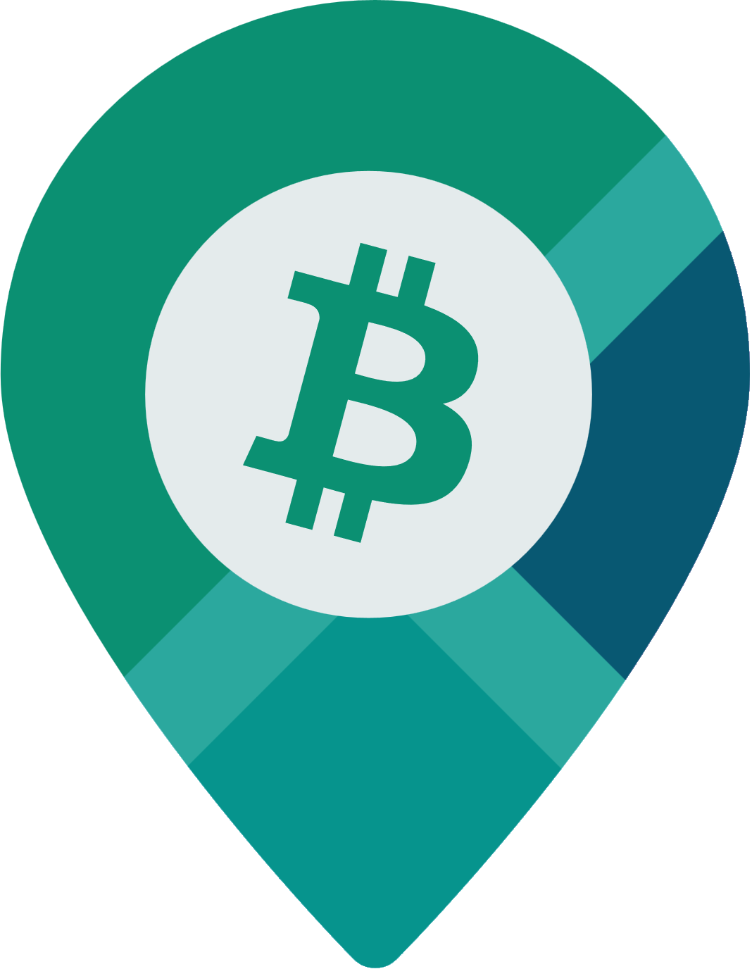
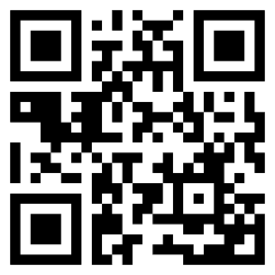
Easily find places to spend sats anywhere on the planet.
https://btcmap.org

Slide 25
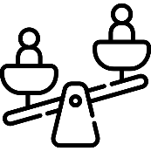
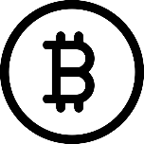
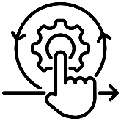
Key Points
01
Fiat money is broken
02
But since 2009 we have an alternative: Bitcoin
03
Using it is a simple as downloading a wallet and saving in bitcoin instead.

Slide 26
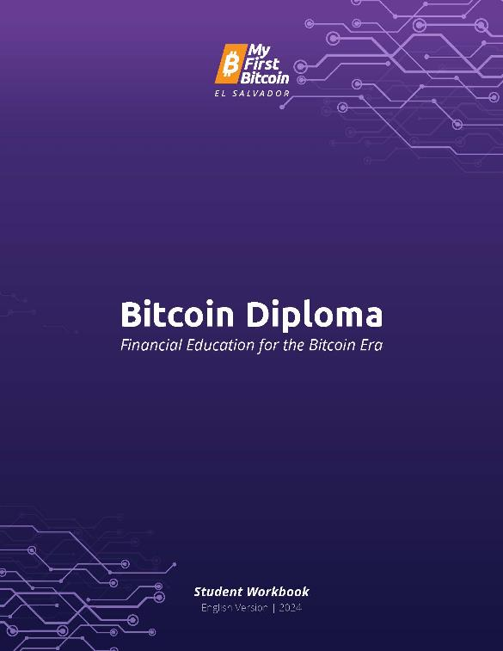


Bitcoin Diploma
Free and Open Source
Impartial & Independent
High-Quality
https://myfirstbitcoin.io
https://github.com/MyFirstBitcoin

Slide 27



Online Courses
Bitcoin Diploma
Instructor Onboarding
Bitcoin for Beginners
Free
Free
Free
https://edu.myfirstbitcoin.io/courses

Slide 28




Learning App - YZER
Earn Bitcoin for learning more
Like Duolingo for Bitcoin
Free to use
https://yzer.io

